Slide 1

Automated reaction discovery through reactive MD simulations
Emilio Martinez nuñez
Departamento de Química Física
Universidade de Santiago de Compostela
SPAIN
Emilio.nunez@usc.es

Slide 2
Outline
Introduction: Basic concepts of chemical kinetics
Our method: AutoMeKin
Applications
Can we predict rate laws of complex reactions?

Slide 3
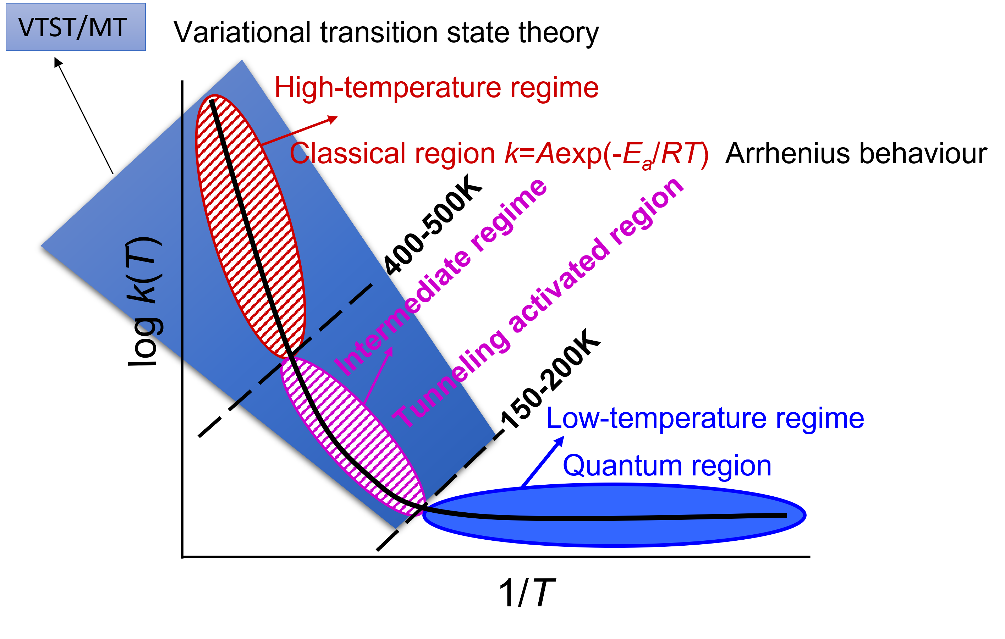
Basic concepts of chemical kinetics

Slide 4
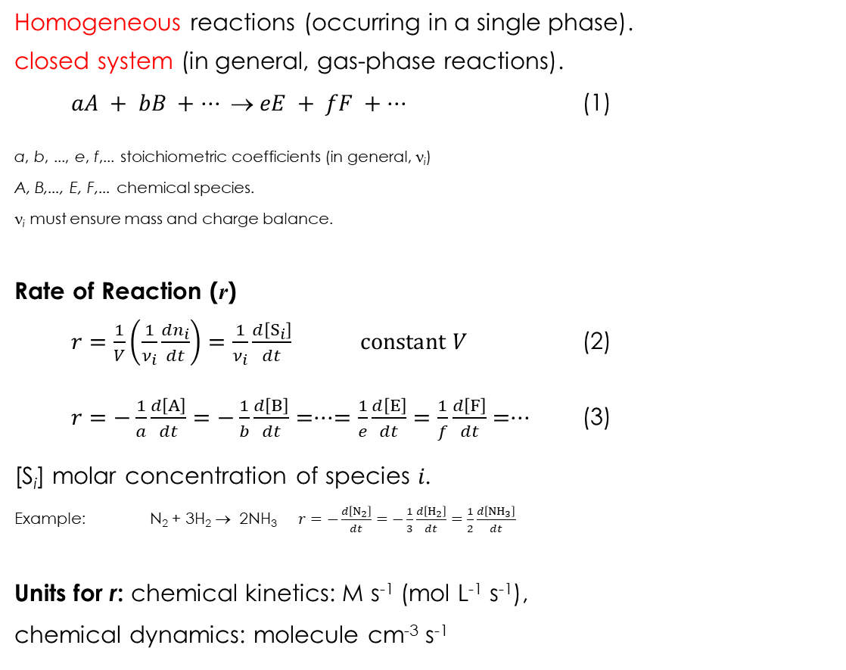
Basic concepts of chemical kinetics I
Homogeneous reactions (occurring in a single phase).
closed system (in general, gas-phase reactions).
$aA + bB + ···  eE + fF + ···$ (1)
a, b, ..., e, f,... stoichiometric coefficients (in general, ν_{i})
A, B,..., E, F,... chemical species.
ν_{i} must ensure mass and charge balance.
Rate of Reaction (r)
$r=\frac{1}{V}\left(\frac{1}{ν_{i}}\frac{dn_{i}}{dt}\right)=\frac{1}{ν_{i}}\frac{d\left[S_{i}\right]}{dt}$ $\text{constant} V$ (2)
$r=−\frac{1}{a}\frac{d\left[A\right]}{dt}=−\frac{1}{b}\frac{d\left[B\right]}{dt}=···=\frac{1}{e}\frac{d\left[E\right]}{dt}=\frac{1}{f}\frac{d\left[F\right]}{dt}=···$ (3)
[S_{i}] molar concentration of species $i$.
Example: N₂ + 3H₂ → 2NH₃ $r=−\frac{d\left[N_{2}\right]}{dt}=−\frac{1}{3}\frac{d\left[H_{2}\right]}{dt}=\frac{1}{2}\frac{d\left[{NH}_{3}\right]}{dt}$
Units for r: chemical kinetics: M s⁻¹ (mol L⁻¹ s⁻¹),
chemical dynamics: molecule cm⁻³ s⁻¹

Slide 5
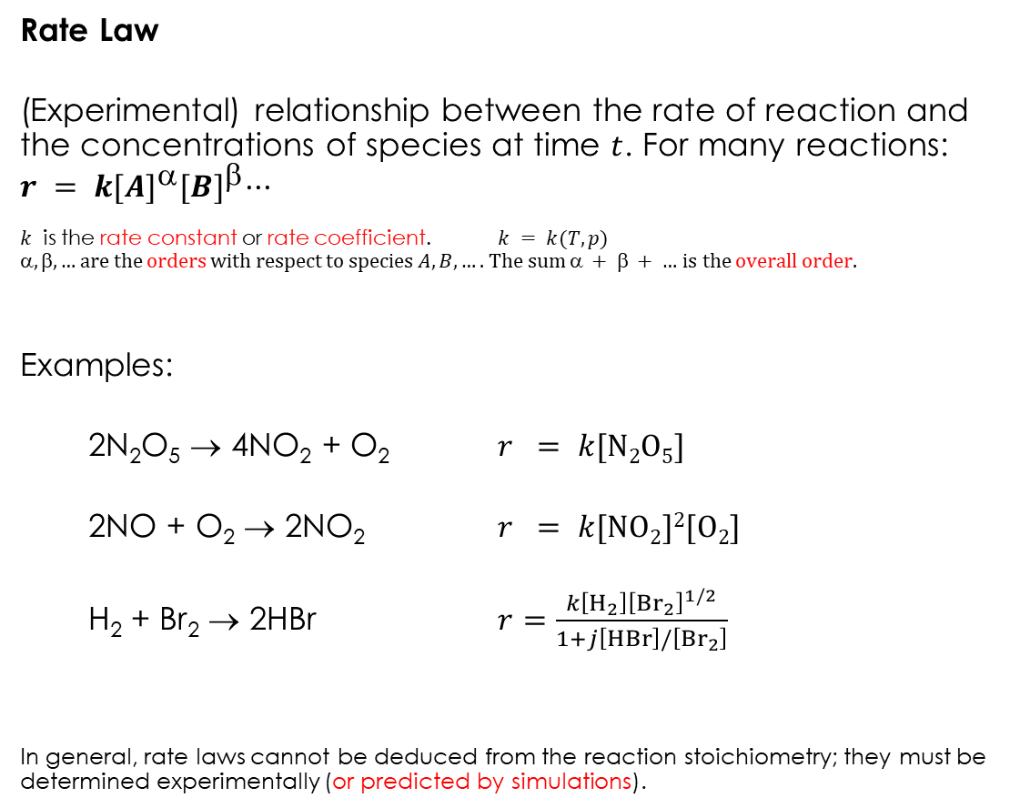
Basic concepts of chemical kinetics II
Rate Law
(Experimental) relationship between the rate of reaction and the concentrations of species at time $t$. For many reactions: $r = k{[A]}^{}{[B]}^{}···$
$k$ is the rate constant or rate coefficient. $k = k(T,p)$
$, , …$are the orders with respect to species $A, B, ….$The sum $ +  + …$is the overall order.
Examples:
2N₂O₅ → 4NO₂ + O₂ $r = k[\text{N}2\text{O}5]$
2NO + O₂ → 2NO₂ $r = k[\text{NO}2]2[\text{O}2]$
H₂ + Br₂ → 2HBr $r=\frac{k\left[H_{2}\right]{\left[{Br}_{2}\right]}^{1/2}}{1+j\left[HBr\right]/\left[{Br}_{2}\right]}$
In general, rate laws cannot be deduced from the reaction stoichiometry; they must be determined experimentally (or predicted by simulations).

Slide 6
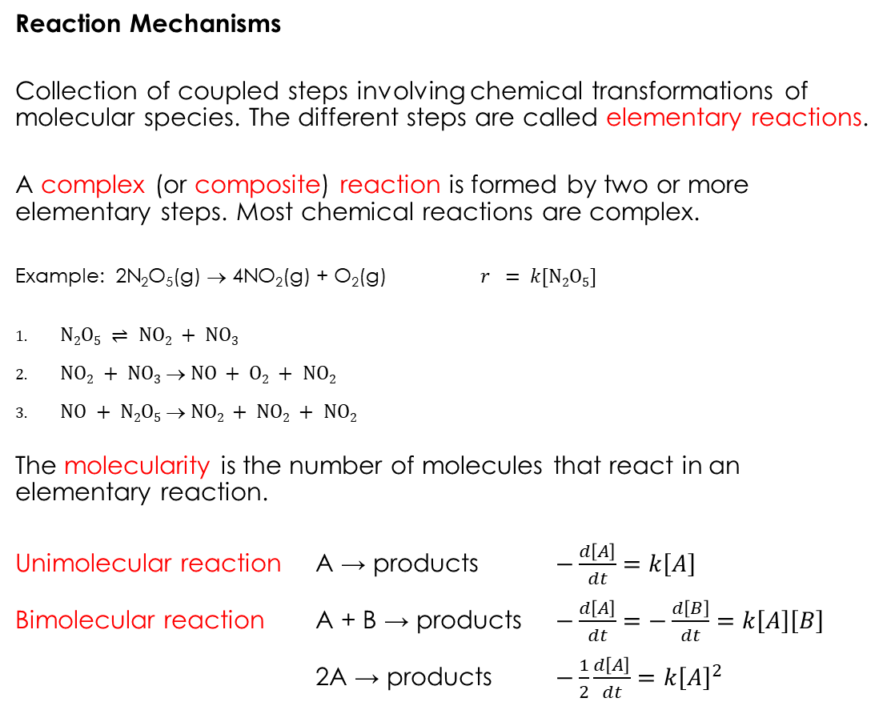
Basic concepts of chemical kinetics III
Reaction Mechanisms
Collection of coupled steps involving chemical transformations of molecular species. The different steps are called elementary reactions.
A complex (or composite) reaction is formed by two or more elementary steps. Most chemical reactions are complex.
Example: 2N₂O₅(g) → 4NO₂(g) + O₂(g) $r = k[\text{N}2\text{O}5]$
$\text{N}2\text{O}5 ⇌ \text{NO}2 + \text{NO}3$
$\text{NO}2 + \text{NO}3 → \text{NO} + \text{O}2 + \text{NO}2$
$\text{NO} + \text{N}2\text{O}5 → \text{NO}2 + \text{NO}2 + \text{NO}2$
The molecularity is the number of molecules that react in an elementary reaction.
Unimolecular reaction A → products $−\frac{d\left[A\right]}{dt}=k\left[A\right]$
Bimolecular reaction A + B → products $−\frac{d\left[A\right]}{dt}=−\frac{d\left[B\right]}{dt}=k\left[A\right]\left[B\right]$
2A → products $−\frac{1}{2}\frac{d\left[A\right]}{dt}=k{\left[A\right]}^{2}$

Slide 7
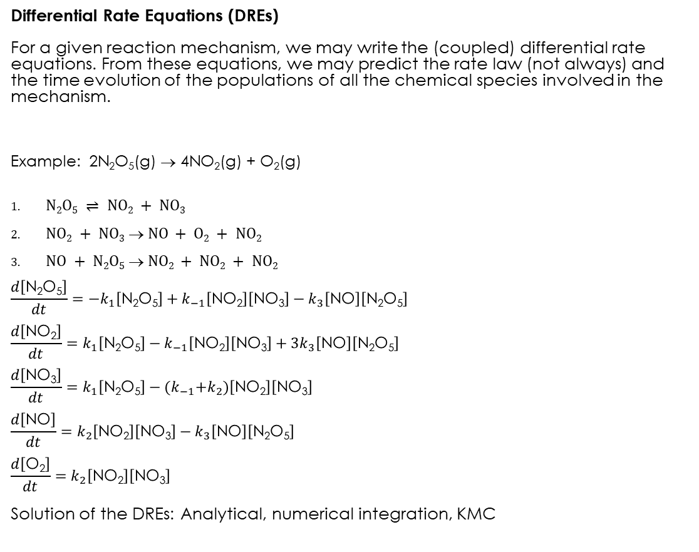
Basic concepts of chemical kinetics IV
Differential Rate Equations (DREs)
For a given reaction mechanism, we may write the (coupled) differential rate equations. From these equations, we may predict the rate law (not always) and the time evolution of the populations of all the chemical species involved in the mechanism.
Example: 2N₂O₅(g) → 4NO₂(g) + O₂(g)
$\text{N}2\text{O}5 ⇌ \text{NO}2 + \text{NO}3$
$\text{NO}2 + \text{NO}3 → \text{NO} + \text{O}2 + \text{NO}2$
$\text{NO} + \text{N}2\text{O}5 → \text{NO}2 + \text{NO}2 + \text{NO}2$
$$\frac{d\left[\text{N}\text{2}\text{O}\text{5}\right]}{dt}=−k_{1}\left[\text{N}\text{2}\text{O}\text{5}\right]+k_{−1}\left[\text{NO}\text{2}\right]\left[\text{NO}\text{3}\right]−k_{3}\left[\text{NO}\right]\left[\text{N}\text{2}\text{O}\text{5}\right]$$
$$\frac{d\left[\text{NO}\text{2}\right]}{dt}=k_{1}\left[\text{N}\text{2}\text{O}\text{5}\right]−k_{−1}\left[\text{NO}\text{2}\right]\left[\text{NO}\text{3}\right]+{3k}_{3}\left[\text{NO}\right]\left[\text{N}\text{2}\text{O}\text{5}\right]$$
$$\frac{d\left[\text{NO}\text{3}\right]}{dt}=k_{1}\left[\text{N}\text{2}\text{O}\text{5}\right]−{(k}_{−1}+k_{2})\left[\text{NO}\text{2}\right]\left[\text{NO}\text{3}\right]$$
$$\frac{d\left[\text{NO}\right]}{dt}=k_{2}\left[\text{NO}\text{2}\right]\left[\text{NO}\text{3}\right]−k_{3}\left[\text{NO}\right]\left[\text{N}\text{2}\text{O}\text{5}\right]$$
$$\frac{d\left[\text{O}\text{2}\right]}{dt}=k_{2}\left[\text{NO}\text{2}\right]\left[\text{NO}\text{3}\right]$$
Solution of the DREs: Analytical, numerical integration, KMC

Slide 8
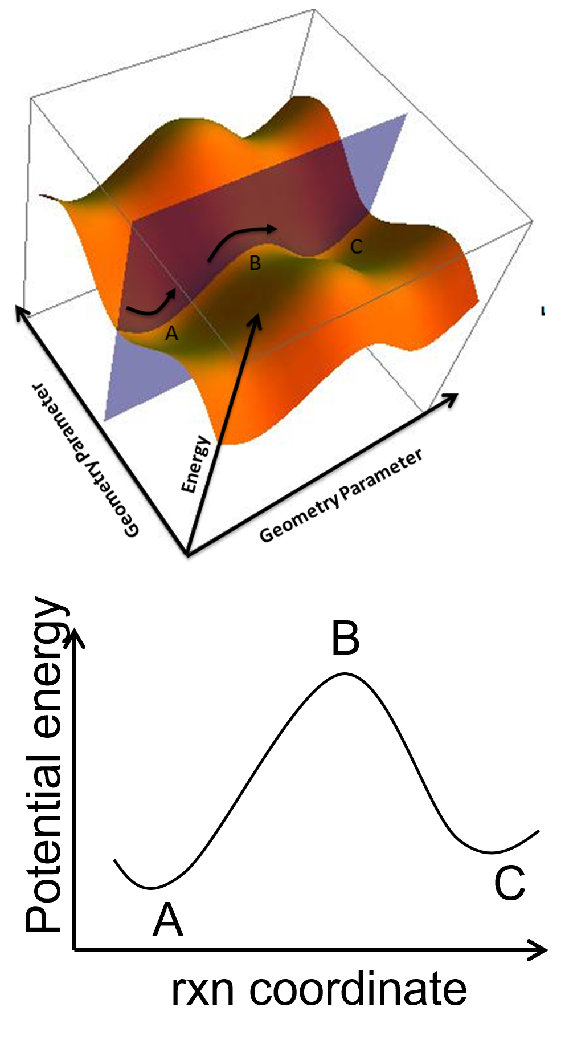
Basic concepts of chemical kinetics V
In terms of PESs, an elementary step involves motion across a single barrier
Notes:
The distinctive feature

Slide 9
Basic concepts of chemical kinetics VI
Important points of the PES: Those in which the gradient is zero (stationary points).
Minima or equilibrium geometries: All the eigenvalues of the Hessian are positive.
Global: Lowest potential energy of the PES.
Local: A point with the lowest potential in a given region.
Reactive intermediate: Metastable local minimum.
Conformers: The set of local minima that can be interconverted by rotations about single bonds.
Saddle points: One or more eigenvalues of the Hessian are negative.
First order: Only one of the eigenvalues is negative.
Second order: Two eigenvalues are negative.
Transition state (TS): First order saddle point relevant for the study of a chemical reaction.
Note: the Hessian is the matrix of second derivatives of the potential with respect to the coordinates (also called force constant matrix).

Slide 10
Basic concepts of chemical kinetics VII
Dependence of $k$ on $T$

Slide 11
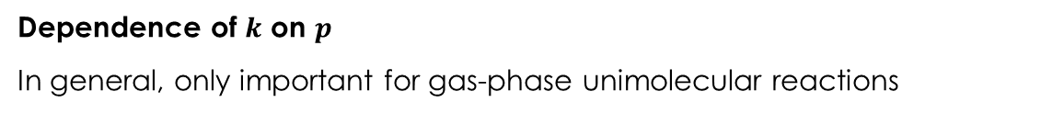
Basic concepts of chemical kinetics VIII
Dependence of $k$ on $p$
In general, only important for gas-phase unimolecular reactions

Slide 12
Our method

Slide 13
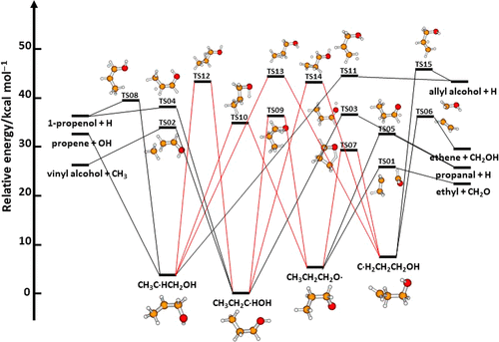
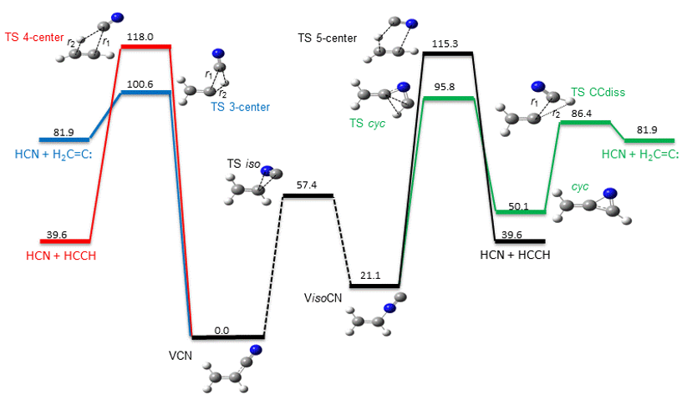
Complex and/or non-intuitive mechanisms
Manual searches:
can be tedious
and might overlook unconventional paths

Slide 14







Main components
J. Comput. Chem. 2015, 36, 222
Phys. Chem. Chem. Phys. 2015,17, 14912
J. Comput. Chem. 2021, 42, 2036
Reactive MD simulations
Reactive event detection (RED)
Optimization and screening
Kinetics
RED
Reactive MD
simulations
Kinetics
TS opt &
screening
Notes:
The distinctive feature

Slide 15
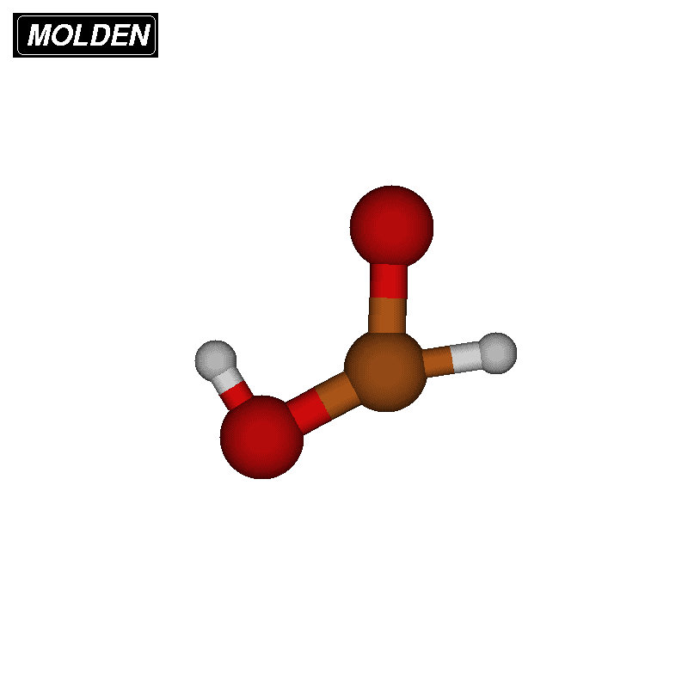
Reactive MD simulations I
Phys. Chem. Chem. Phys. 2015,17, 14912
Standard MD: high E or T and short:
QCT
microcanonical/canonical sampling
adaptive energy range
movie (210 kcal/mol)

Slide 16
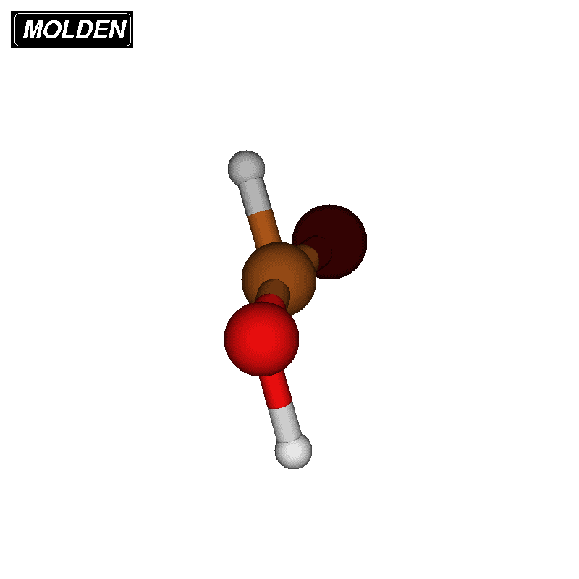
Reactive MD simulations II
ChemSystemsChem 2020, 152, e19002
Rare-event acceleration method (BXDE):
energy boxes
more efficient sampling
loose coupling via ASE
movie: Langevin 1000 K

Slide 17
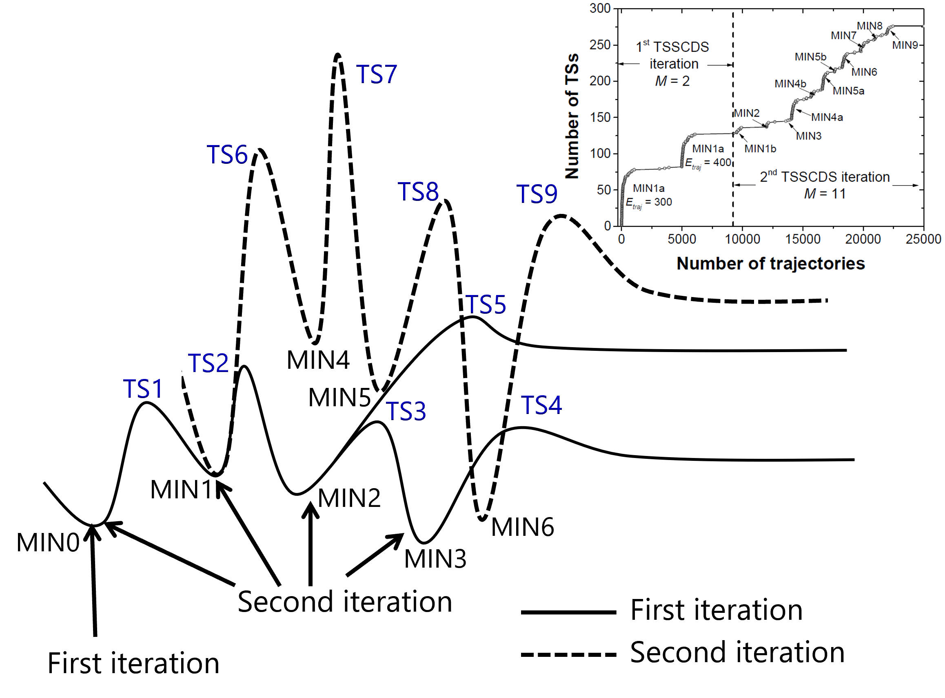
Reactive MD simulations III
Phys. Chem. Chem. Phys. 2015,17, 14912
Trajectories start from multiple minima

Slide 18
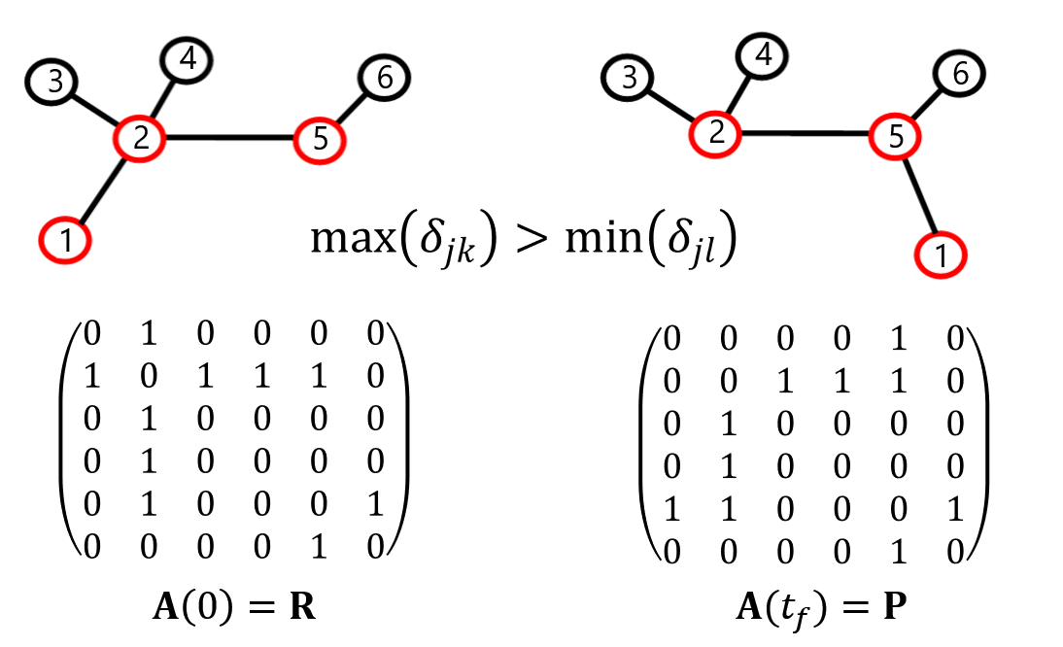
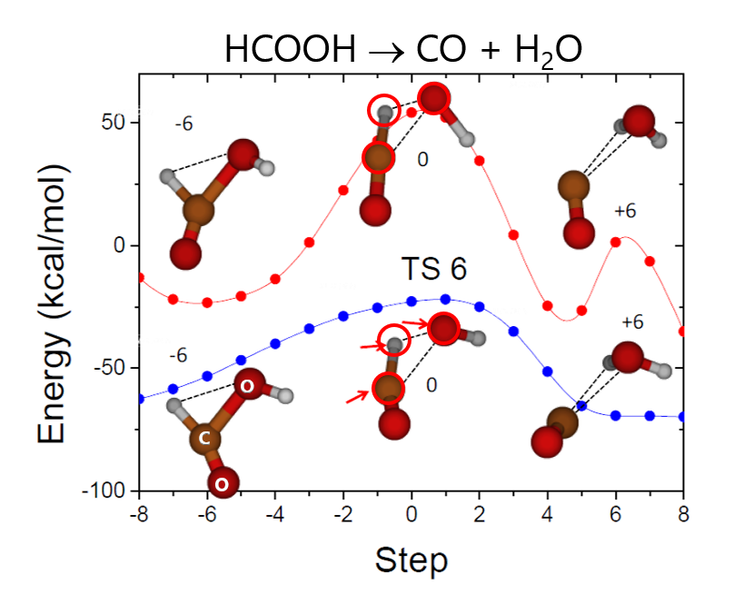
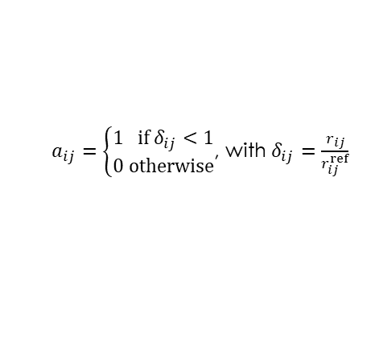
Reactive event detection I: (BBFS)
Algorithm based on the adjacency matrix
Relaxation of atoms not involved in the reaction
$a_{ij}=\left\{\begin{aligned}1 if δ_{ij}<1 \\ 0 otherwise\end{aligned}\right.$, with $δ_{ij}=\frac{r_{ij}}{r_{ij}^{ref}}$
Notes:
Weighted adjancency matrix

Slide 19
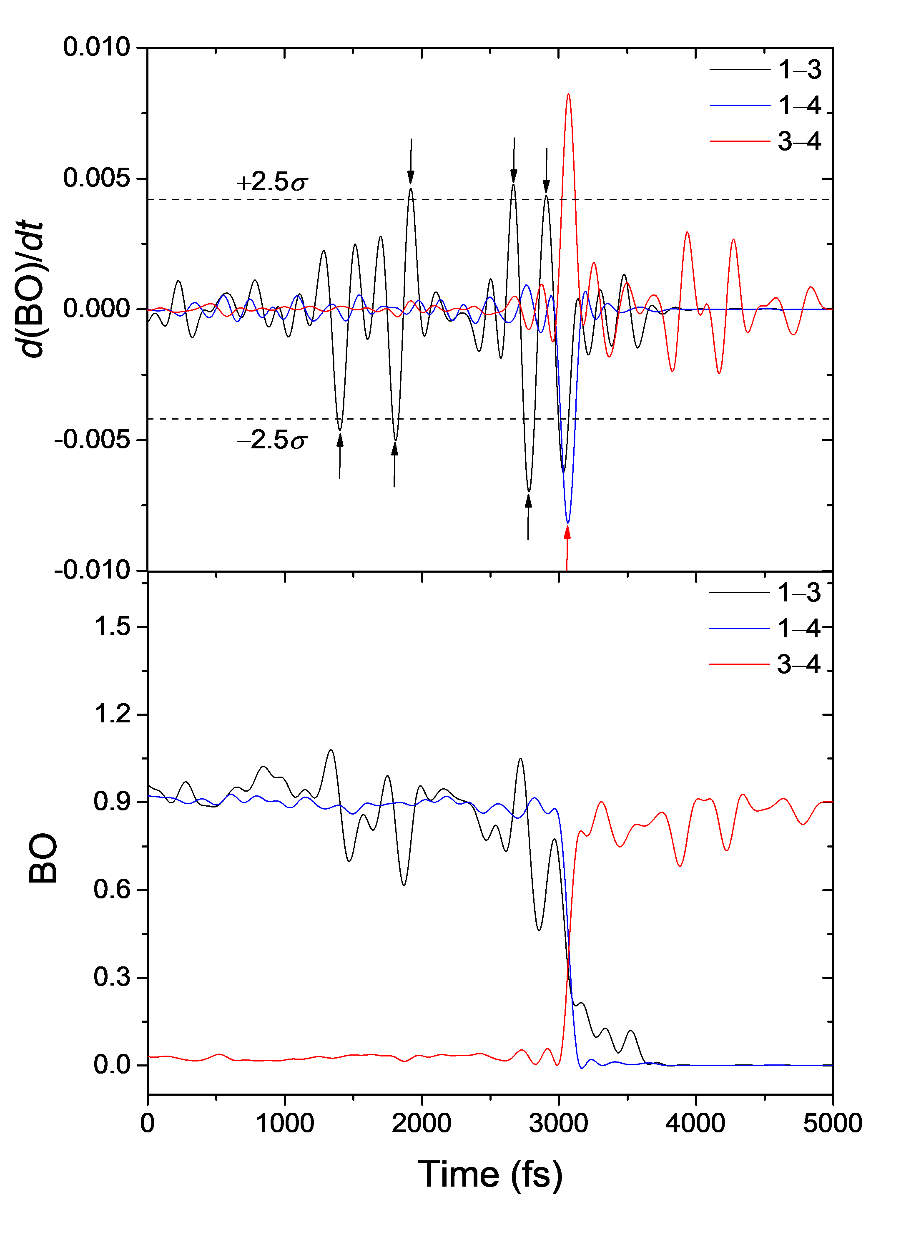
Reactive event detection II: (BOTS)
JCTC, 2020, 16, 1606
Algorithm based on the bond orders
Relaxation of atoms not involved in the reaction

Slide 20
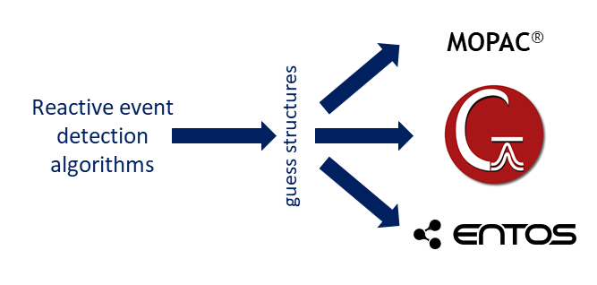
Optimization
Single-ended methods: MOPAC, G09, G16, Entos Qcore

Slide 21
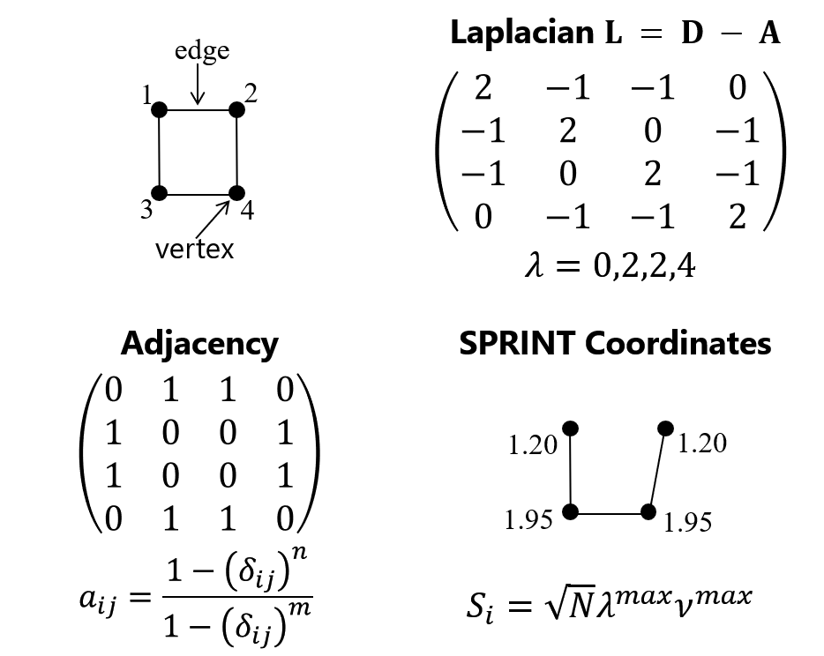
Screening
Molecules, 2018, 23, 3156
PRL, 2011, 107, 085504
Spectral Graph Theory & SPRINT coordinates

Slide 22
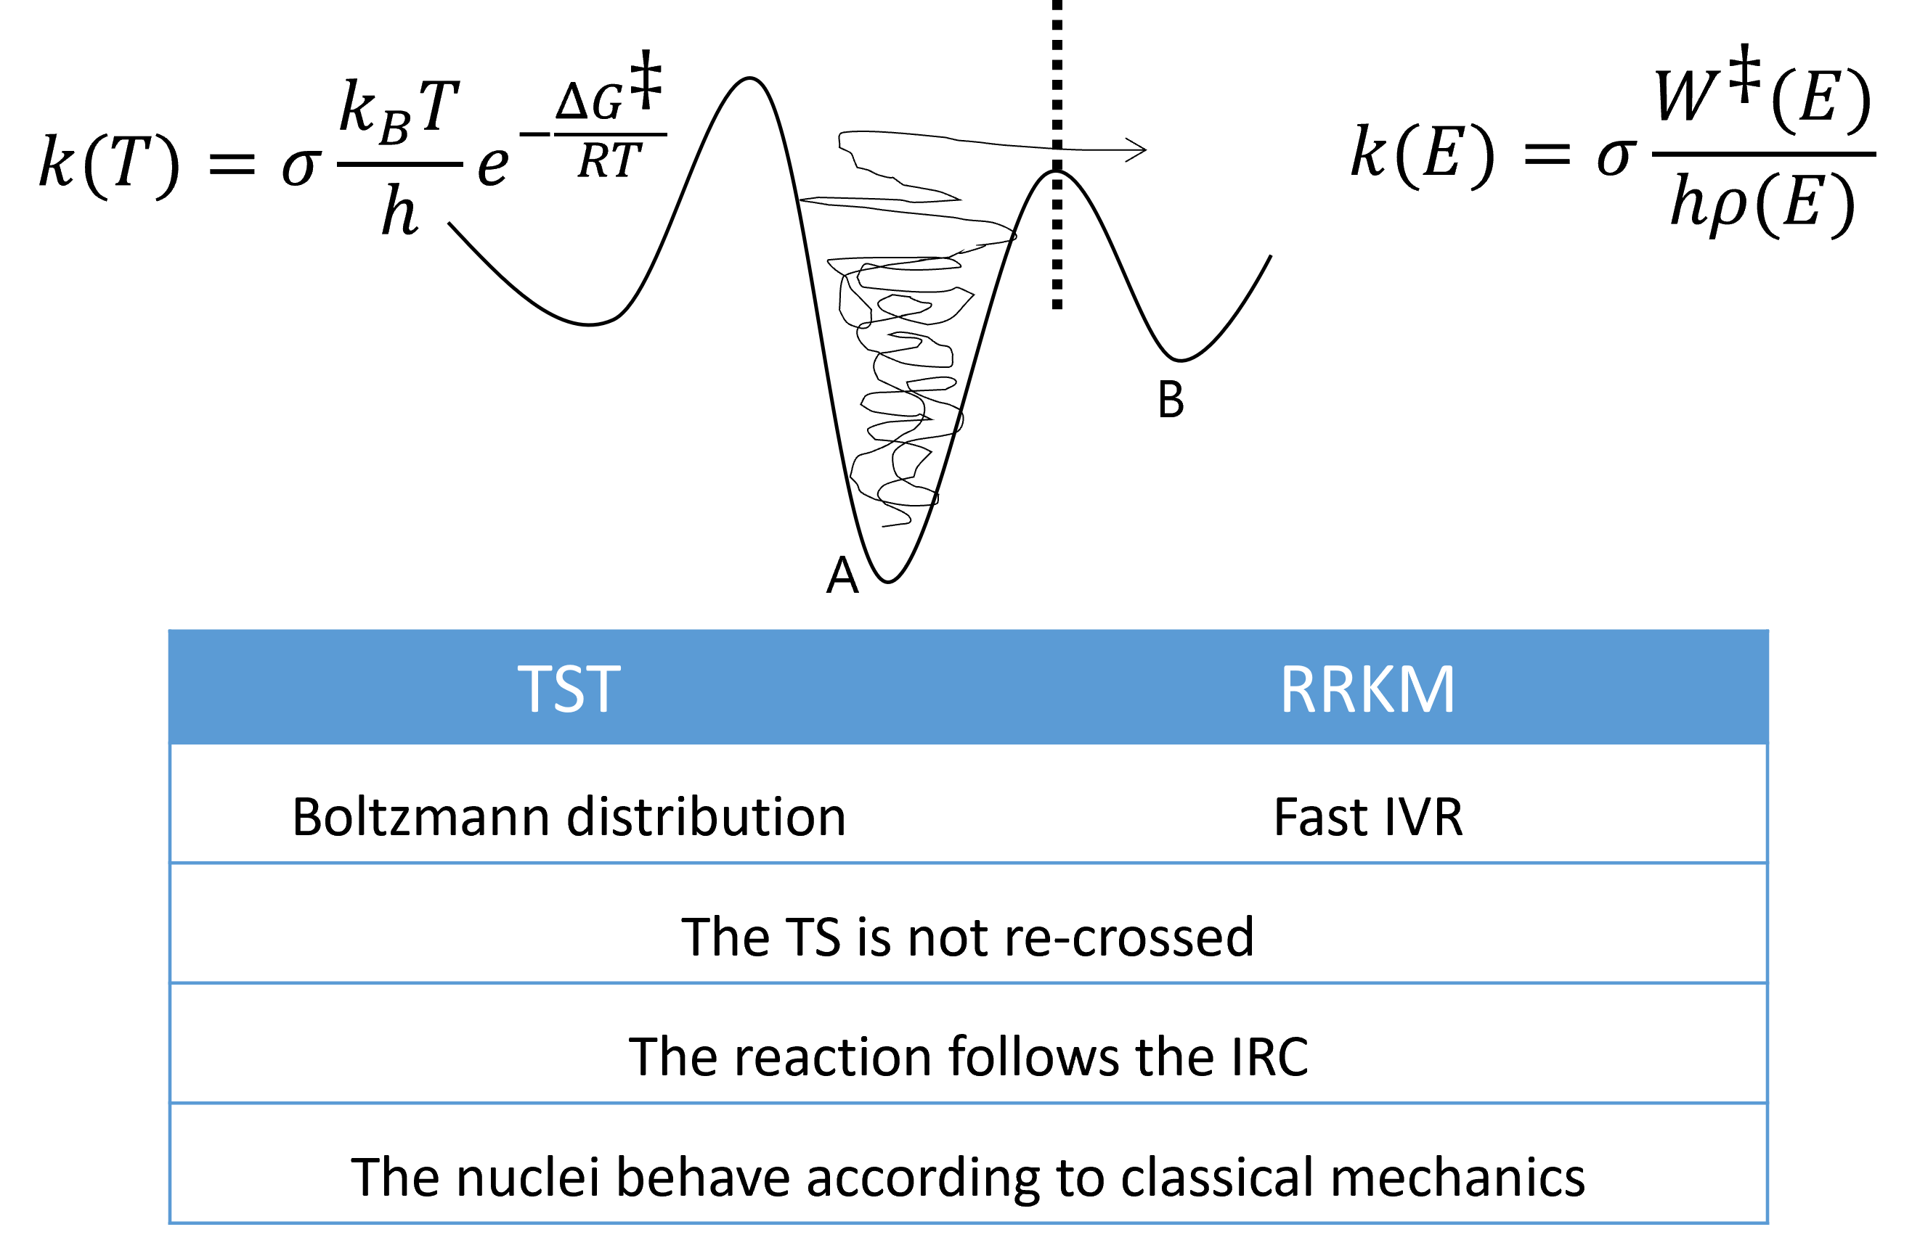
Kinetics I
TST/RRKM

Slide 23
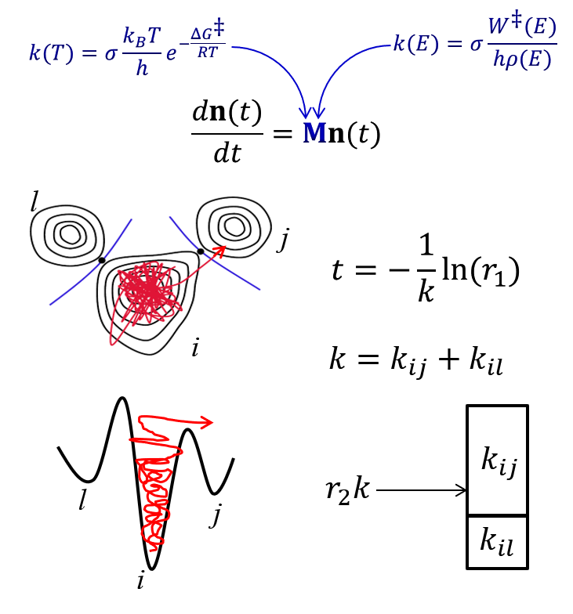
Kinetics II
Chemical Master Equation: KMC

Slide 24
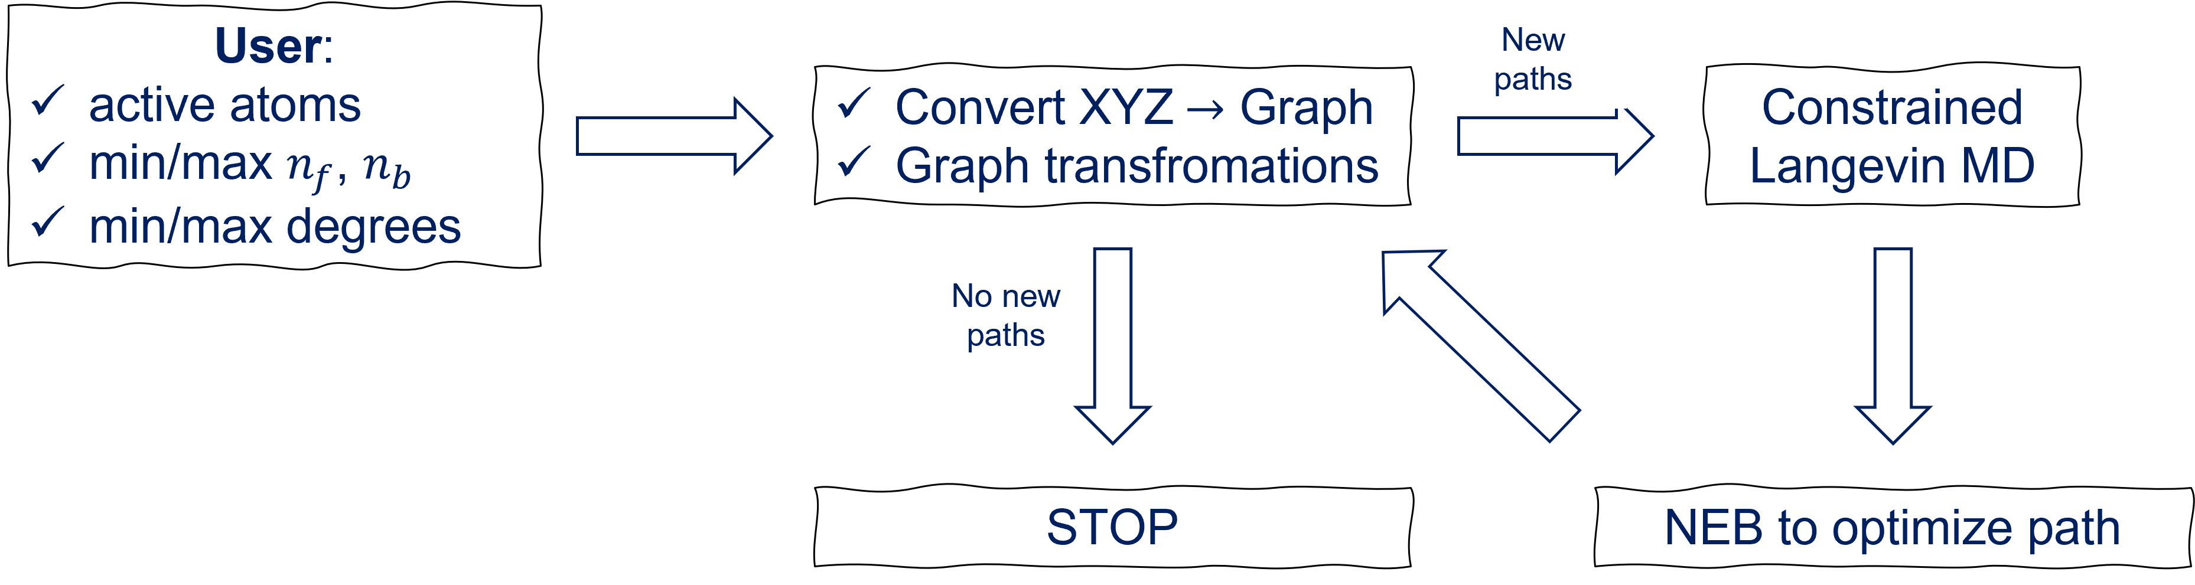
New capabilities I: ChemKnow
J. Comput. Chem. 2021, 42, 2036

Slide 25
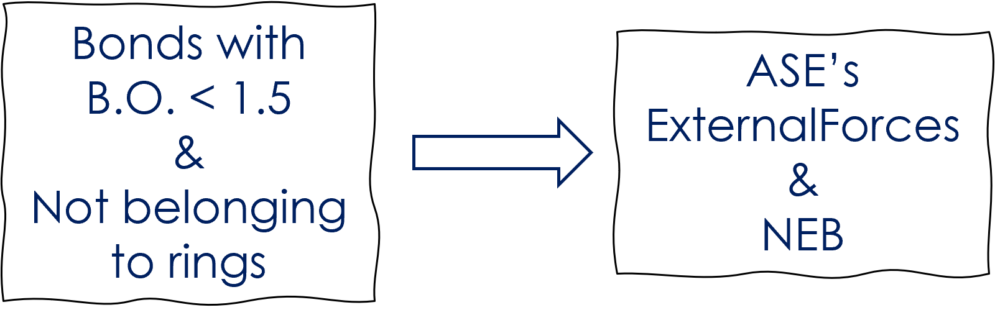
New capabilities II: Barrierless reactions
ACS Physical Chemistry Au 2022 (accepted)

Slide 26
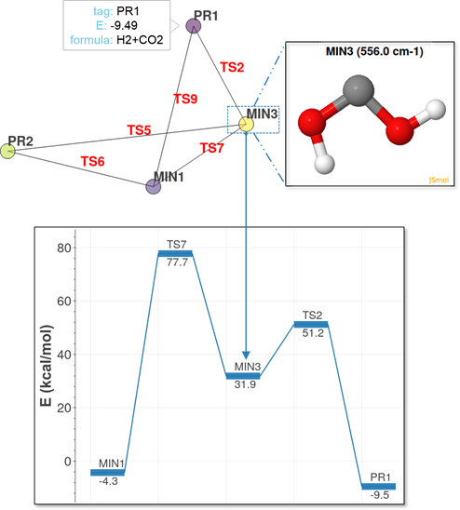
New capabilities III: amk_tools & web app
ACS Physical Chemistry Au 2022 (accepted)
amk_tolos & web application

Slide 27
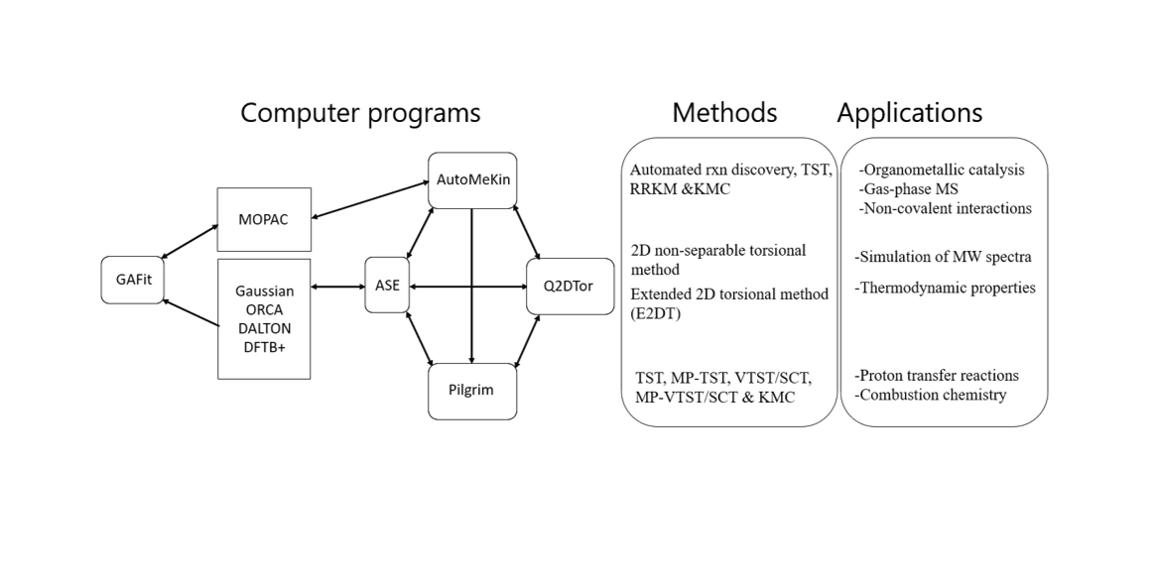



Integrated computational platform
Algorithms for finding
Conformational
Isomers
Torsiflex

Slide 28

Computer program
tsscds2018: J. Comput. Chem., 2018, 39, 1922
AutoMeKin2021: J. Comput. Chem., 2021, 42, 2036
https://rxnkin.usc.es/index.php/AutoMeKin

Slide 29
Applications

Slide 30
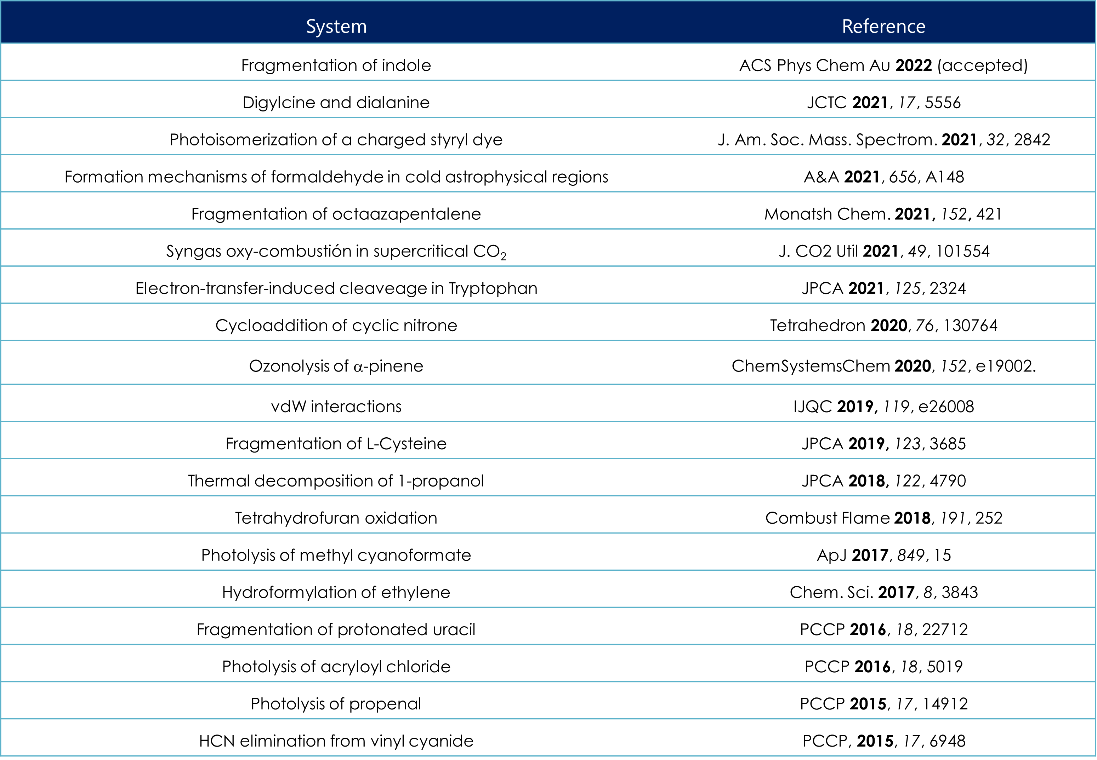



Systems studied so far

Slide 31
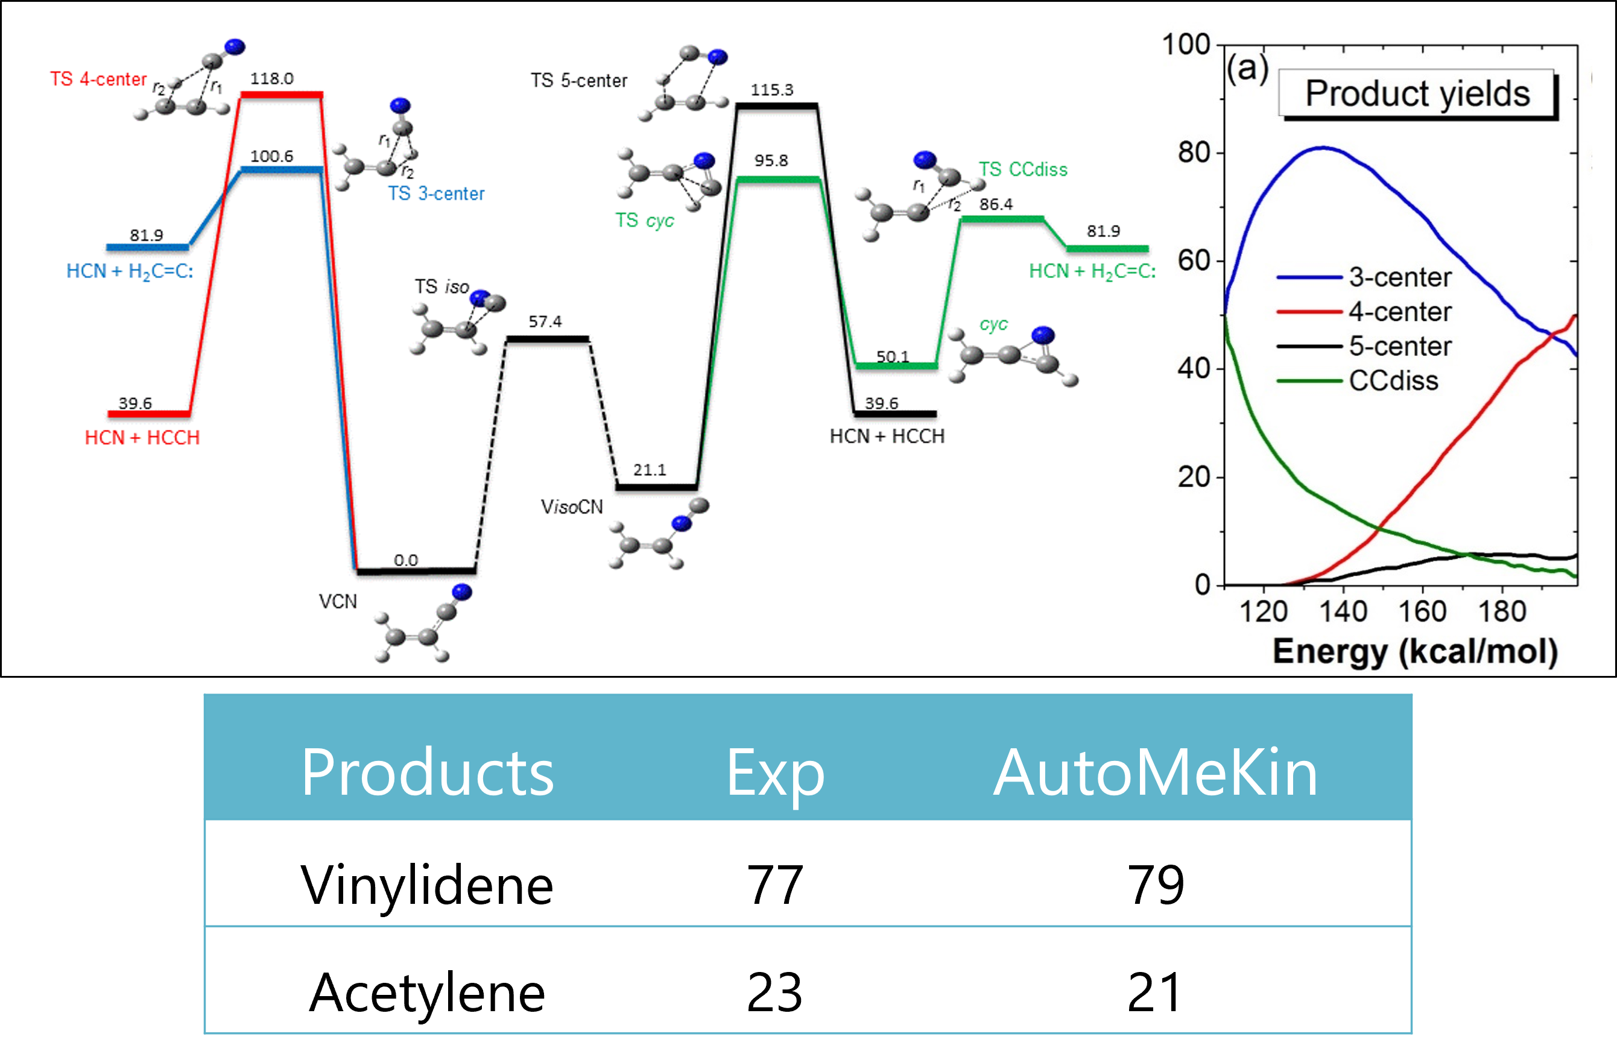
HCN elimination from vinyl cyanide
PCCP 2015, 17, 6948

Slide 32
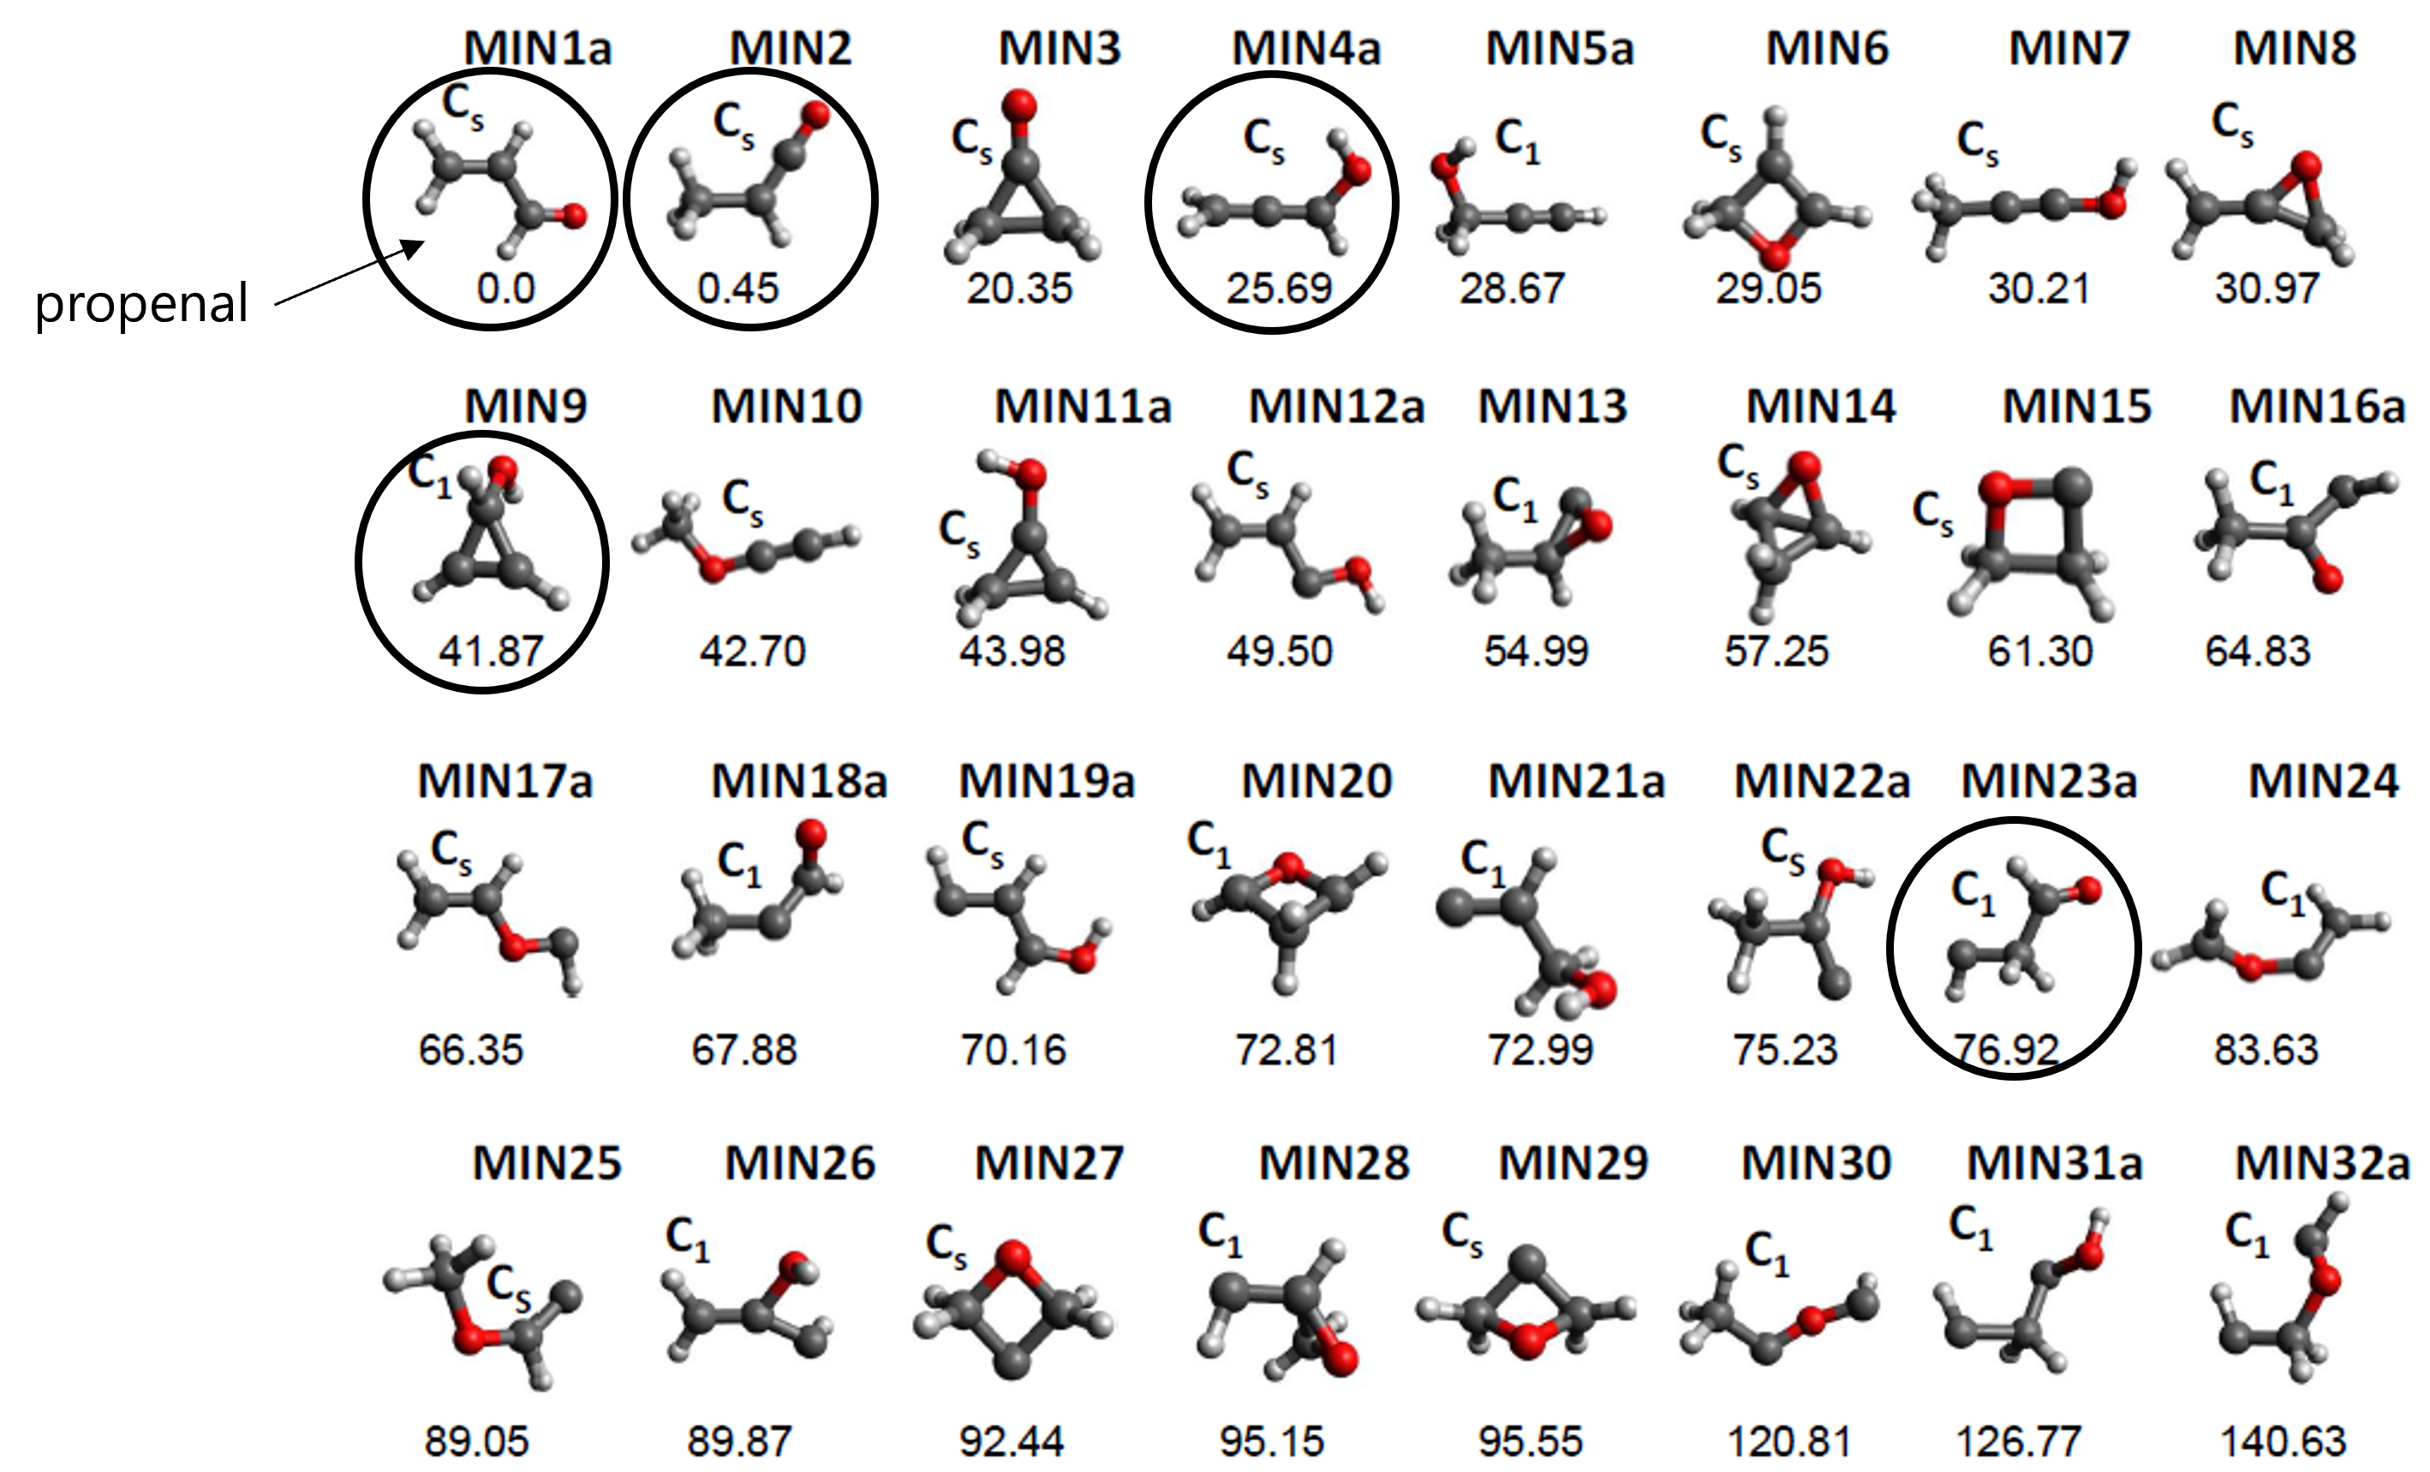
Photolysis of propenal
PCCP 2015, 17, 14912
JCP 2011, 134, 044309
CCSD(T)/6-311+G(3df,2p)//B3LYP/6-311G(d,p)

Slide 33
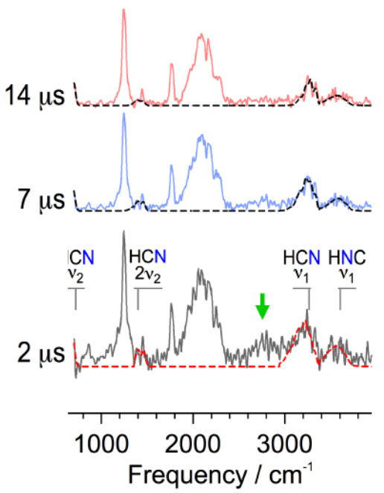
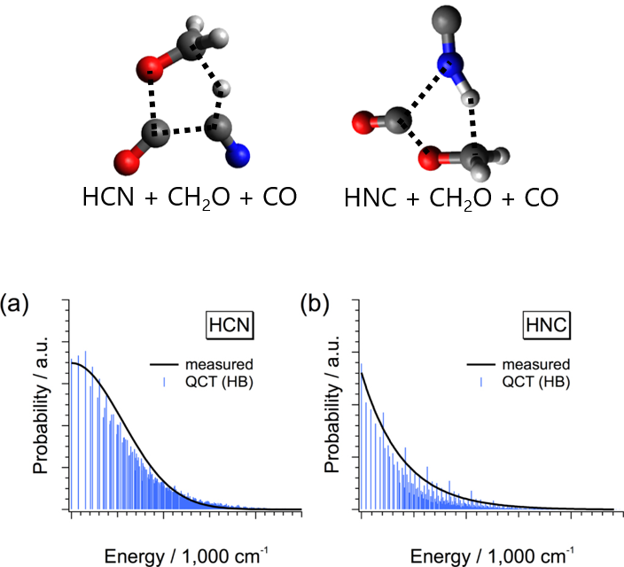
Photolysis of methyl cyanoformate
ApJ. 2017, 849, 15
Time-resolved IR spectra
Evidence of
HCN(HNC) formation
AutoMeKin & QCT
Top: AutoMeKin’s TSs
Bottom: Vibrational distros

Slide 34
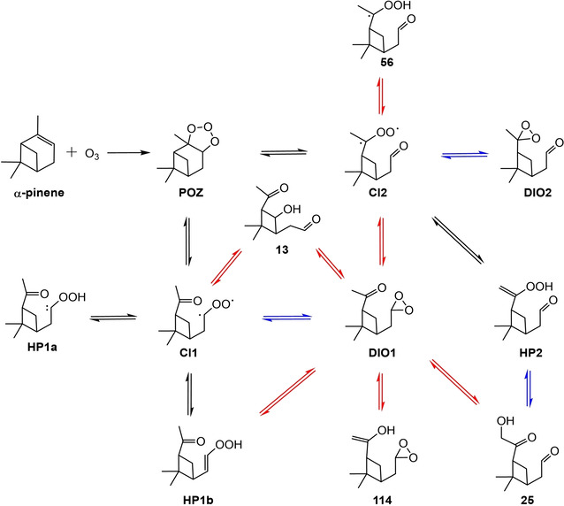
Ozonolysis of α-pinene
ChemSystemsChem 2020, 152, e19002
Reaction networks
Top: stdMD
Bottom: BXDE
Mechanism
Blue: stdMD & BXDE
Red: Only BXDE

Slide 35
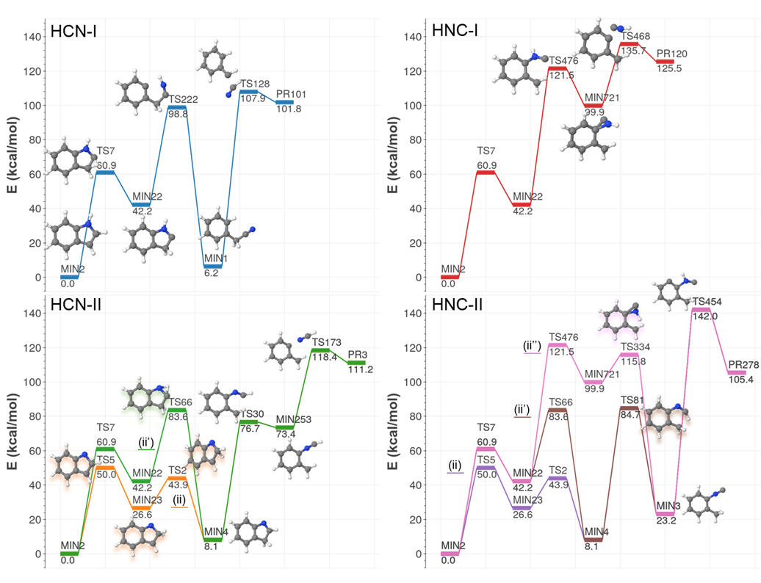
Unimolecular decomposition of indole I
ACS Physical Chemistry Au 2022 (accepted)
HCN elimination paths

Slide 36
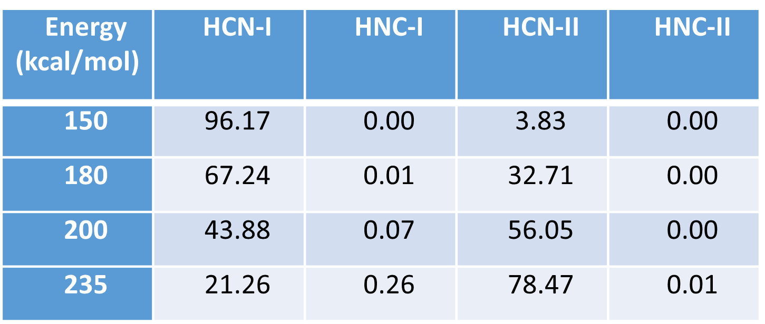
Unimolecular decomposition of indole II
ACS Physical Chemistry Au 2022 (accepted)
Astrochemistry:
barrierless formation of indole
HNC/HCN abundance
Notes:
Phenyl isocyanide

Slide 37
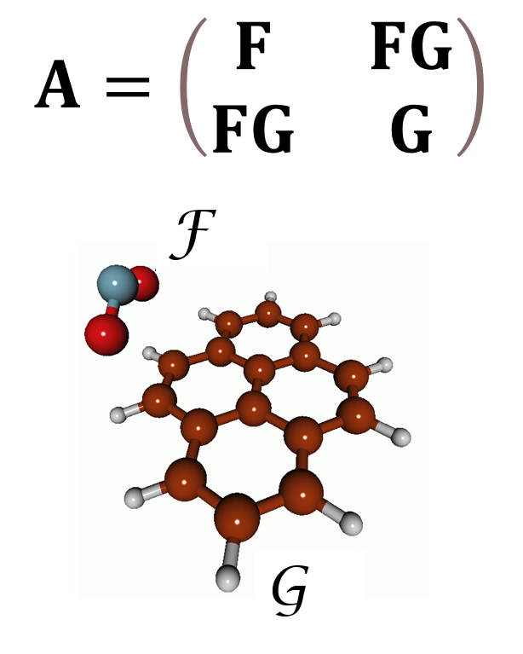
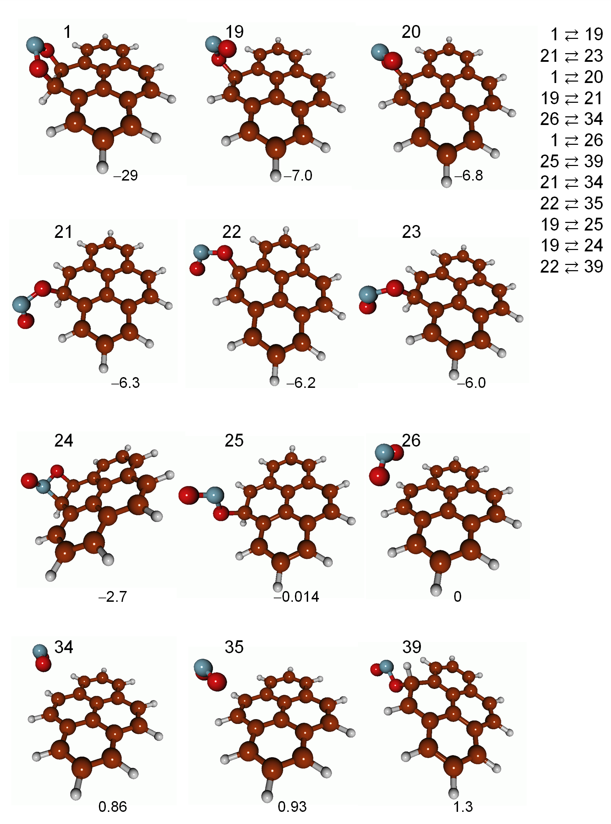
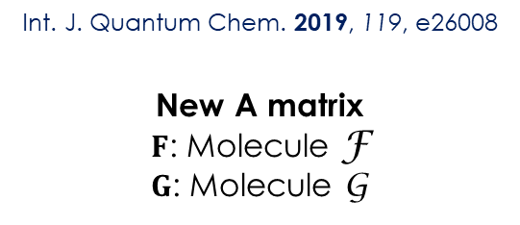
vdW interactions
Int. J. Quantum Chem. 2019, 119, e26008
New A matrix
$F$: Molecule F
$G$: Molecule G
NO₂-pyrene
Most stable minimum-energy structures

Slide 38
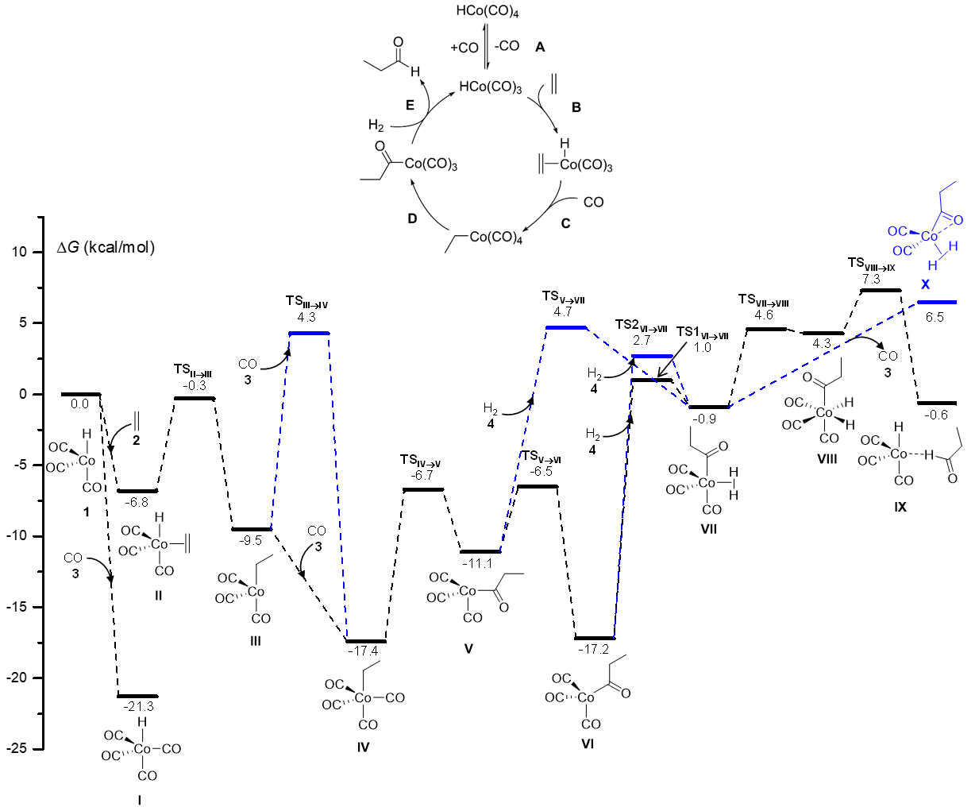
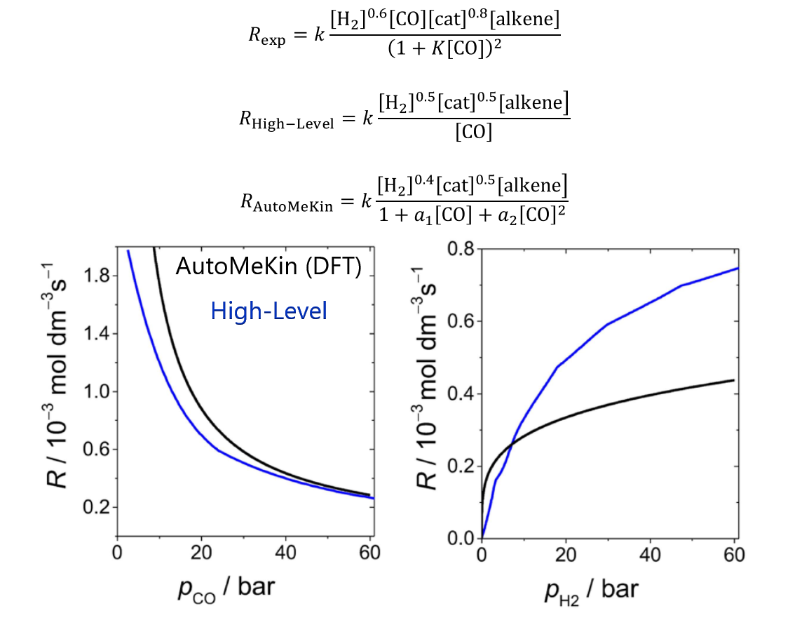
Can we predict rate laws of complex reactions?
Co-catalyzed hydroformylation of ethylene: Chem. Sci 2017, 8, 3843
Major mechanism
Formation of propanal
Kinetics
Rate laws

